Slide 1

Design and analysis of algorithms (CSE 2012)
Prepared by
Dr.S.Jenicka
Assistant professor senior grade 2
SCOPE-Analytics
VIT Vellore

Slide 2
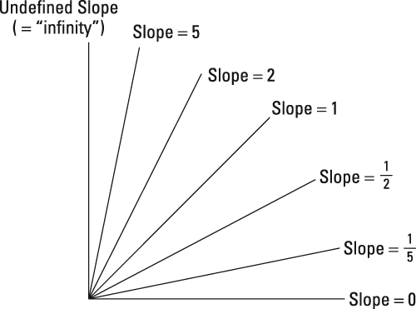
Lines of increasing slope

Slide 3
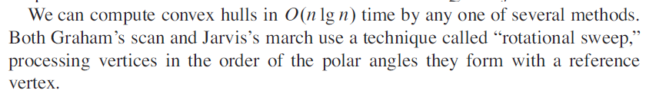
Algorithms for constructing convex hull

Slide 4
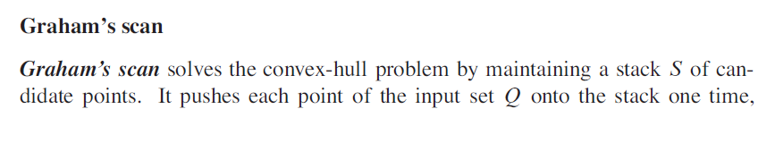
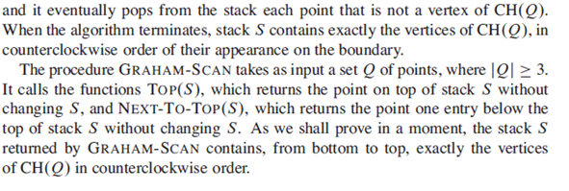
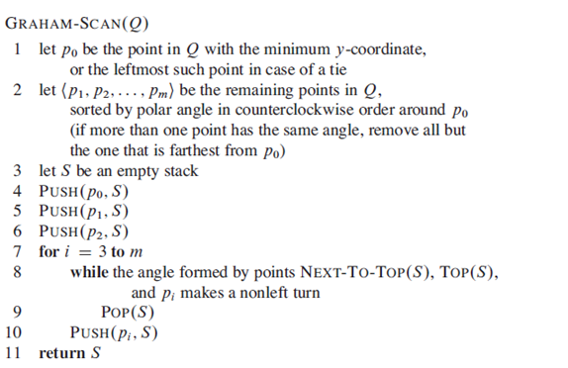
Graham’s scan convex hull algorithm

Slide 5
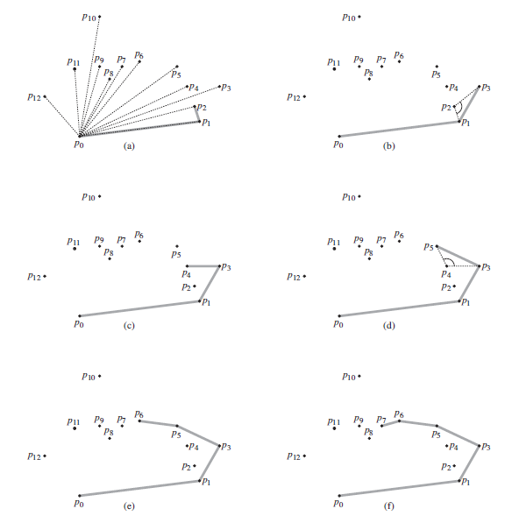

Slide 6
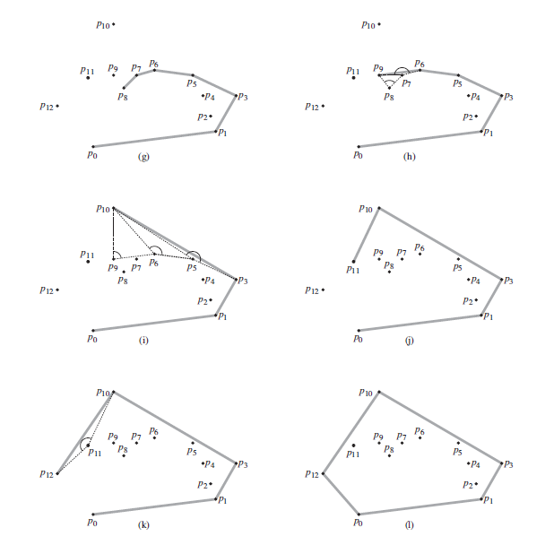

Slide 7
Time complexity
Time complexity = O(nlogn) because soring algorithm takes O(nlogn) time

Slide 8
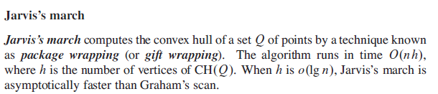
Jarvis’s March convex hull algorithm or Package wrapping algorithm

Slide 9
Jarvis’s March convex hull algorithm
1) Initialize p as leftmost point.
2) Do following while we do not come back to the first (or leftmost) point.
a) The next point q is the point such that the triplet (p, q, r) is counterclockwise for any other point r.
b) next[p] = q (Store q as next of p in the output convex hull).
c) p = q (Set p as q for next iteration).

Slide 10
Jarvis’s March Pseudocode
jarvis(S)
// S is the set of points
pointOnHull = leftmost point in S //which is guaranteed to be part of the Hull(S)
i = 0
repeat
P[i] = pointOnHull
endpoint = S[0] // initial endpoint for a candidate edge on the hull
for j from 1 to |S|
if (endpoint == pointOnHull) or (S[j] is on left of line from P[i] to endpoint)
endpoint = S[j] // found greater left turn, update endpoint
i = i+1
pointOnHull = endpoint
until endpoint == P[0] // wrapped around to first hull point

Slide 11
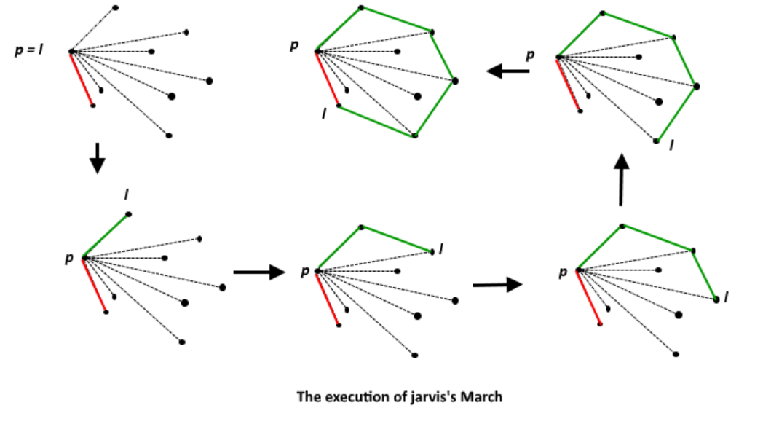
Tracing Jarvis’s March algorithm

Slide 12
Time complexity
Time complexity=O(nh) where n is the number of given points and h is the number of points in the convex hull. If n=h, then time complexity is O(n²)

